Slide 1
CARCINoGENESIS Dr. Fahd AL-MULLA
Phase II 2009
Lecture available http://www.al-mulla.org

Slide 2
Target knowledge
What is carcinogenesis
What is carcinogen
Examples of carcinogens
Chemicals
Physical
Zoonoses
Initiators and promoters
Environment and cancer
Genetics and cancer
Oncogenes/tumour suppressor genes
Accumulation of genetic events Vogelstein’s model
Environmental and Genetic interaction

Slide 3
Carcinogenesis
Process by which a normal cell is transformed into a malignant cell
Neoplasia has genetic and environmental causes.
It is important to note that both play parts in causing neoplasia.
Genes influence the environmental factors

Slide 4
Genetic basis of cancer
Introduction of genes (activated oncogenes) in normal Cells in culture make them transformed
Transgenic mice/knock-in/out mice (mice with new onco-Genes introduced in cells at early embryological stages or removing genes from them) have a higher incidence of cancer
Patients with well known inherited cancer syndromes in which inheritance of a single mutated gene have increased Risk of developing cancer.

Slide 5
Genetic basis of cancer
Oncogenes
Proto-oncogenes are normal cellular genes that regulate cell growth, division, and differentiation.
Oncogenes are cancer-causing genes derived from proto-oncogenes by mutation (ras), retroviral transduction, gene amplification (myc and erbb2), or translocation (bcr-abl).
Tumour suppressor genes
Tumor suppressor genes are normal cell genes that "brake" cell division, activate apoptosis and repair DNA. Knudson two hit hypothesis.

Slide 6
Genetic basis of Cancer: Vogelstein Model
Tumour progression implies the gradual transition of a localised, slow growing tumour to an invasive, metastatic cancer
It was Vogelstein et al (1988)who put a firm molecular footing for the concept of multistep carcinogenesis
As tumours progress to cancer they accumulate more genetic abnormalities.
Deletions involving 17p (p53) were most frequent in carcinomas (75%) and were rarely found in early adenomas.

Slide 7
Genetic basis of cancer: Vogelstein’s Model

Slide 8
Environmental basis of cancer

Slide 9
Carcinogens
Agent | Occupation | Cancer Site
Ionizing radiations radon | certain underground miners | bronchus
X-rays, radium | radiologists, radiographers | skin
Radium | luminous dial painters | bone
Ultraviolet radiation | farmers, sailors, etc. | skin
Polycyclic hydrocarbons in soot | chimney sweepers,oil workers | scrotum, skin, bronchus
2-Naphthylamine; 1-naph-thylamine | rubber workers | bladder
Benzidine; 4-aminobiphenyl | chemical workers | bladder
Asbestos | shipyard and insulation workers | Mesothelioma lung
Arsenic | sheep dip manufacturers, gold miners | skin and bronchus
Benzene | workers with glues, varnishes, etc. | marrow (leukemia
Vinyl chloride | PVC manufacturers | liver (angio-sarcoma)
Aflatoxin B1 | Food storage. Due to growth of Aspergillus flavus (fungi) | Liver
Benzo(a)pyrene | Smokers | Lung
It was Sir Percival Pott in 1775 who associated the increased incidence of scrotal skin cancer to chronic
exposure to soot in chimney sweepers.
one Or a group of agents are to produce a neoplasm they have to damage
more than one gene. Thus, the Neoplastic transformation is a progressive process involving multiple “hits”or genetic changes.

Slide 10
How do Carcinogens work?
Electrophiles (N,O,?S)
Direct DNA damage or metabolites
Pyrimidine Dimers (UV light)
Radiation cosmic rays (DNA breaks)
Dioxin in plastics
Carcinogen can be initiator (incomplete)
Carcinogen can be initiator and promoter (complete). E.g. virus

Slide 11
Carcinogens initiation/promotion
Initiator: Initiation results from the exposure of cells to a certain doze of a carcinogen (initiator). An initiated cell is altered making it more likely to give rise to a tumour (if exposed to another agent; group 2 and 3
Promoters are compounds or processes (inflammation, viruses) that activates cell cycle
Initiators and promoters work together
Some agents are initiators and promoters do you know of any?

Slide 12
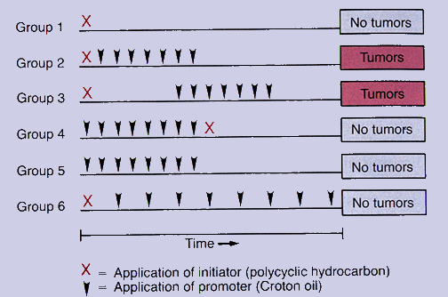
Carcinogens initiation/promotion

Slide 13
Carcinogens initiation/promotion
Initiation
Results from interaction of chemical with DNA to activate a proto-oncogene or inactivate a tumor suppressor gene by formation of covalent adducts.
Chemicals that can form adducts (direct acting) are usually electrophiles.
Many chemical carcinogens require activation by metabolic pathways (pro-carcinogens or indirect acting carcinogens) an example of a metabolic pathway is the p-450 cytochrome mono-oxygenase.
Initiation alone does not result in tumours.
Promotion
Promoters are usually irritants or substances that produce cell activation and proliferation.
Effects of promoters are reversible.
Promoters cannot induce neoplasia: i) alone, ii) if applied before initiator, iii) if applied in too small an amount for effect, or iv) if too much time elapses between applications.

Slide 14
Genetic and environmental interactions
Why do carcinogens produce effect if we can repair DNA?
Not all smokers get Lung cancer! Why?
Amos et al Nature Genetics April 2008 conclude that variation in a region of 15q25.1 containing nicotinic acetylcholine receptors genes contributes to lung cancer risk.

Slide 15
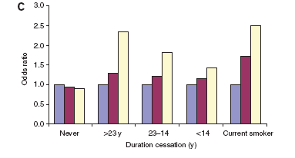
Genetic and environmental Interactions

Slide 16
Thank you
Any Questions?

