Slide 1
Colorectal cancer
Pathogenesis
By
Dr. Fahd Al-Mulla

Slide 2
Objectives
To understand the molecular basis of CRC
Progression theory of CRC
Adenomas and other benign conditions
Carcinomas grading and staging
MIN versus CIN
Hereditary CRC

Slide 3
Polyps
ANY mucosal bulging, blebbing, or bump
NON-NEOPLASTIC e.g Inflammatory, hyperplastic, hamartomatous.
NEOPLASTIC (pre-malignant ): adenomatous.
  TUBULAR vs. VILLOUS vs. TUBULOVILLOUS
SESSILE vs. PEDUNCULATED
Familial polyposis syndromes
  NON-NEOPLASTIC: hamartomatous
  NEOPLASTIC: ADENOMATOSIS
HNPCC: (Hereditary Non Polyposis Colorectal Cancer)

Slide 4

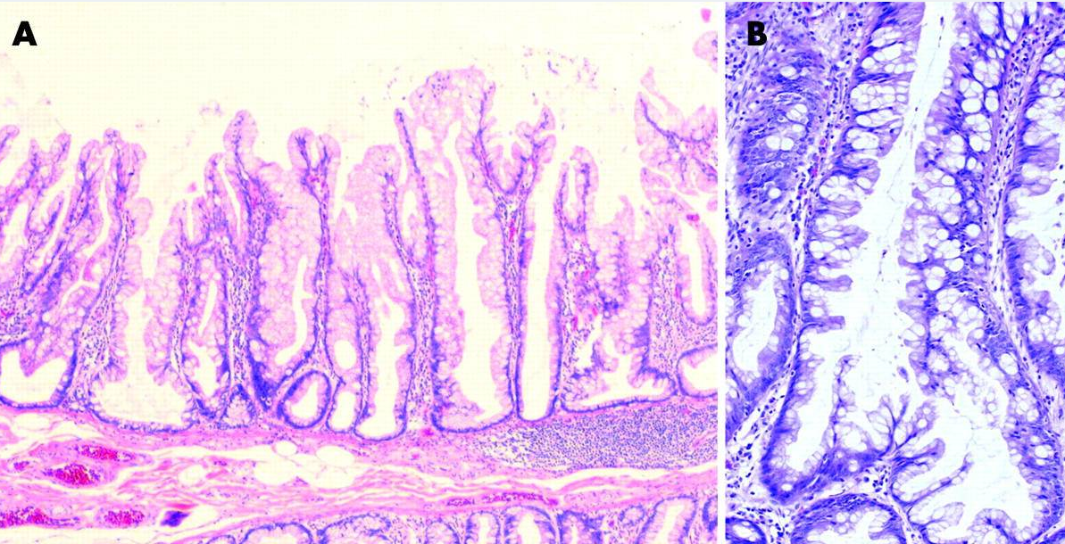
Hyperplastic Polyps and serrated molecular pathway
H&E stains of two hyperplastic polyps (HP) described as sessile serrated adenoma (SSA) by Torlakovic et al and Goldstein et al. (A) Low power view of a variant HP in which there is a hypermucinous epithelium showing crypt dilatation and horizontal extension of crypts immediately above the muscularis mucosae. (B) Medium power magnification of a variant HP showing exaggerated serration, crypt dilatation, and crypt branching, but no definite evidence of dysplasia.

Slide 5
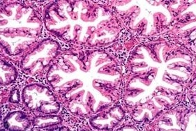
Hyperplastic Polyp
hypermucinous epithelium
crypt dilatation and horizontal extension of crypts
?Pathogenesis:
Malignant Potential higher than previously thought.
BRAF mutation V600E, CIMP-H, MSI

Slide 6
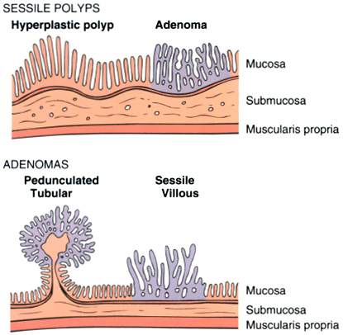
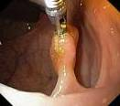
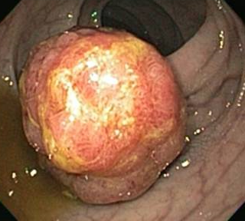
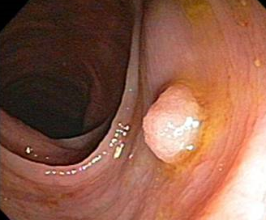
Classical
Adenomas
Macroscopically
Flat “undecided” Sessile polyps
Laterally Spreading Tumors
Protruding: Pedunculated /neck

Slide 7
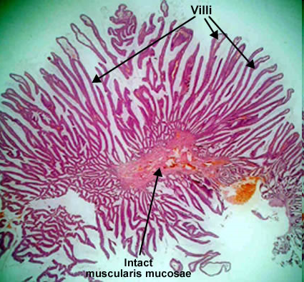
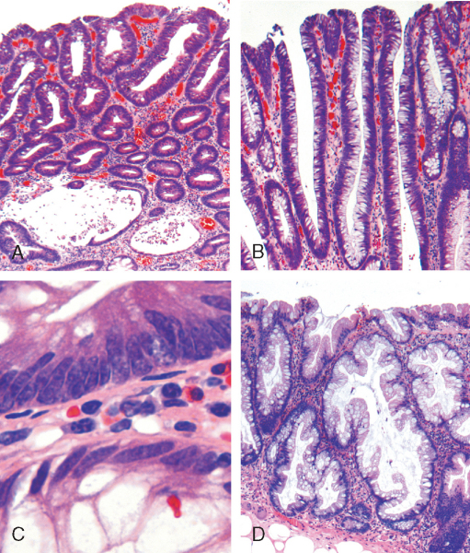
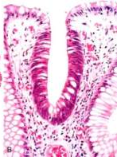
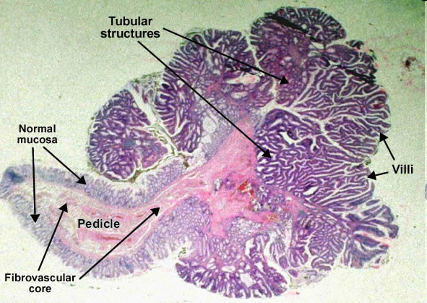
Remember: CRC arises sporadically from pre-malignant adenomas
Microscopically
Villous, tubular or tubulovillous
Villous
Dysplasia: low or high grade
No invasion
Minority of adenomas progress to cancer. Why?
Tubular
Dysplasia
Is there invasion??
Is this cancer??
Tubulovillous

Slide 8
Factors determining risk of malignant transformation within
colonic adenomatous polyps
High risk
Large size (especially > 1.5 cm)
Sessile or flat
Severe dysplasia
Villous architecture
Presence of squamous metaplasia
Polyposis syndrome (multiple polyps)
Low risk
Small size (especially < 1.0 cm)
Pedunculated
Mild dysplasia
Tubular architecture
No metaplastic areas
Single polyp

Slide 9
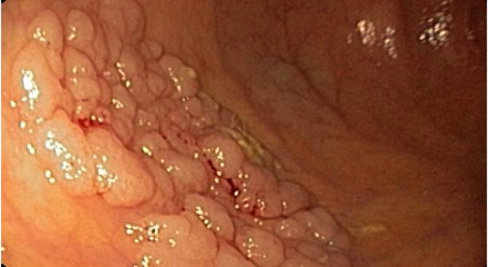
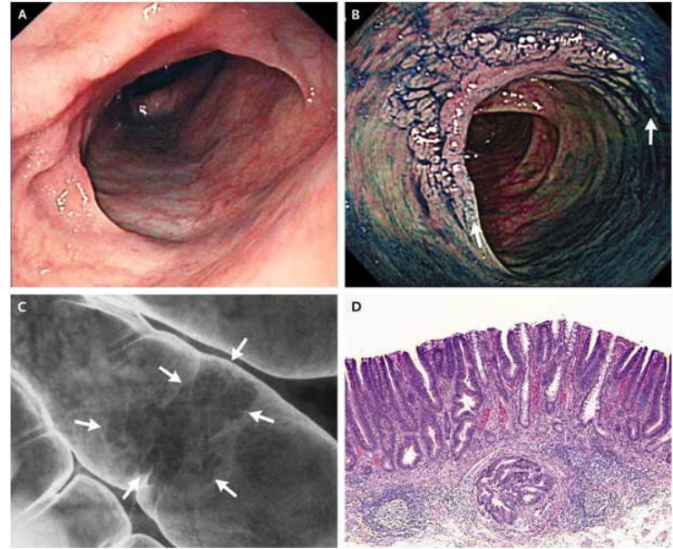
Laterally Spreading Tumours
0.2 percent indigo carmine solution

Slide 10
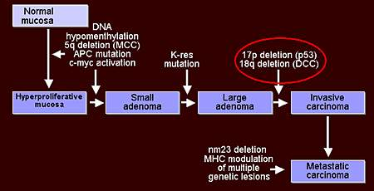
Multistep progression model
BRAF
Ki-Ras

Slide 11
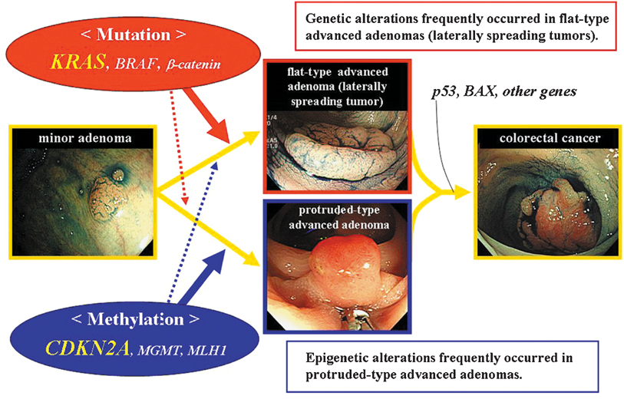
Modern Pathology (2007) 20, 139–147

Slide 12
CRC
A predominantly a disease of the developed countries, and is less common in Africa and Asia
Immigrants from low incidence countries to countries with high incidence of the disease acquire the risk of the indigenous population
Diet may account for the marked geographical variation in incidence
IBD
Environmental/ alcohol, meat, Lack of exercise /Obesity
Bacteroides fragilis new study
Genetic

Slide 13
CRC
44% left including rectum, Right sided 38%, transverse 18%,
Which in your opinion presents bigger/late??
Peak incidence 60-80 years (In Kuwait 52-years)
STAGING: Most important prognostic factors is the extent of the tumour (T), Lymph nodes involvement (N) and presence of metastasis
Other important prognostic factors: Grade, molecular
  Ki-Ras/p53
  BRAF, methylation/CIMP profiles in serrated cancer

Slide 14
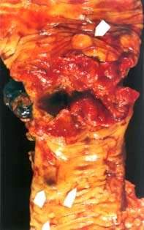
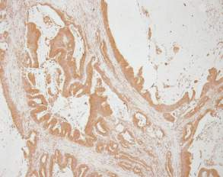
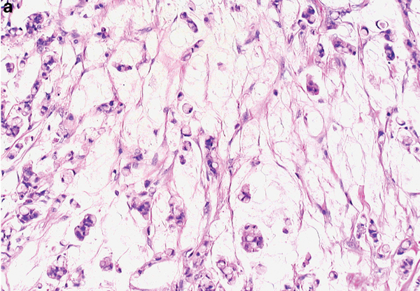
Differentiation
Glandular
Mucinous

Slide 15
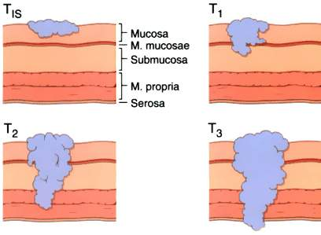

Slide 16
Comparison of Staging Systems for Colorectal Adenocarcinoma
Dukes' | TNM | TNMª |  |  | Modified Astler-Coller
A | I | Tis | N0 | M0 | A
 |  | T1T2 | N0 | M0 | B1
B | II | T3T4a | N0 | M0 | B2
 |  | T4b | N0 | M0 | B3
C | III | T1T2 | N1N2N3* | M0 | C1
 |  | T3T4a | N1N2N3 | M0 | C2
 |  | T4b | N1N2N3 | M0 | C3
D | IV | Any T | Any N | M1 | D
ª Tis: Carcinoma in situ; T1: Tumor invades submucosa; T2: Tumor invades muscularis propria; T3: Tumor invades through the muscularis propria into the subserosa or into nonperitonealized pericolic or perirectal tissues; T4a: Tumor perforates the visceral peritoneum; T4b: Tumor (is adherent to or) directly invades other organs or structures (surgical or pathological definition). N0: No regional metastasis; N1: Metastasis in 1-3 pericolic or perirectal lymph nodes; N2: Metastasis in 4 or more pericolic or perirectal lymph nodes; N3: Metastasis in any lymph node along the course of a named trunk. M0: No distant metastasis; M1: Distant metastasis. Note: T4 is substaged and information in parentheses added to more clearly define patients with differential failure risks. * Lymph nodes beyond those encompassed by standard resection of the primary tumor and regional lymphatics (eg, retroperitoneal nodes) are considered distant metastasis. From O'Connell MJ and Gunderson LL, World J Surg 16:510-515, 1992. Source: Am Society Clinical Oncology Educational Book, 1994.

Slide 17
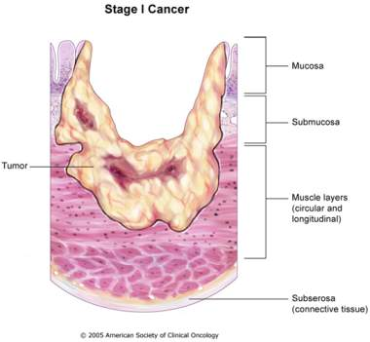
Carcinomas
T1 or T2, N0, M0

Slide 18
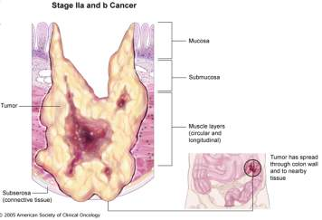
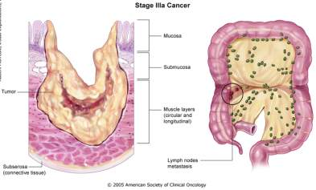
T3, N0, M0
T1 or T2; N1, M0
T4, N0, M0

Slide 19
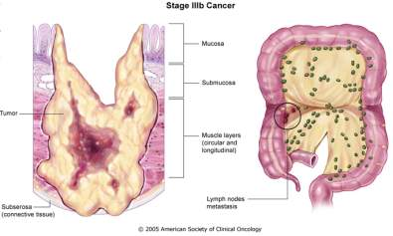
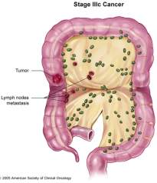
Carcinoma
T3 or T4, N1, M0
any T, N2, M0

Slide 20
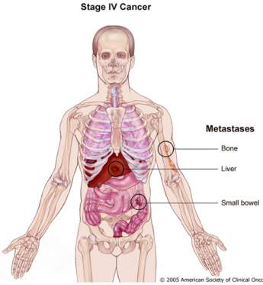
any T, any N, M1
Why is Colon cancer metastasis common in liver?
Why does rectal cancer metastasizes to lung more frequently?

Slide 21
Hereditary CRC
In 1-15 % of patients there seems to be a hereditary predisposition to colorectal cancer
Familial adenomatous polyposis (FAP) is inherited in an autosomal dominant fashion and has been shown to involve germline mutations and deletions of APC alleles
Hereditary non-polyposis coli (HNPCC) is another autosomal dominant hereditary disease

Slide 22
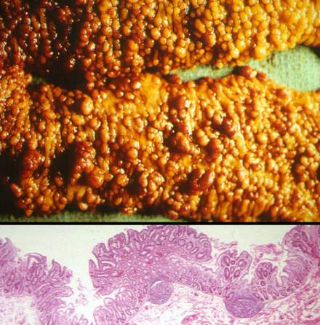
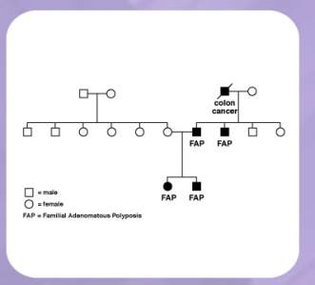
Hereditary CRC (FAP)

Slide 23
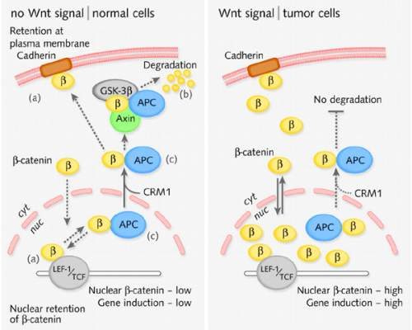
Nuclear-cytoplasmic shuttling of -catenin. In normal, non-stimulated cells, -catenin (indicated here as ' ') is bound to various interacting partners. Its distribution is therefore dictated by (a) retention in the nucleus, the cytoplasm and at the plasma membrane; (b) degradation in the cytoplasm; and (c) the movements of APC. In tumor cells (or Wnt-stimulated cells), -catenin accrues to very high levels and is likely to shuttle independently of APC (wild-type or mutant). Some tumor-associated forms of -catenin may show reduced anchorage by E-cadherin (Chan et al., 2002). The functional implications of -catenin shuttling are poorly understood.

Slide 24
HNPCC
Individuals with HNPCC are prone to develop right-sided colorectal cancer at a young age.
Cancer is poorly differentiated and Patients’ survival is better.
Development of carcinoma of the endometrium, ovary, breast, stomach and urinary tract .
Mutation or deletion of mismatch repair genes MLH1 or MSH2 or MSH6 or PMS2
13 % of sporadic colorectal cancers harbour defective mismatch repair genes MSH2 and MLH1

Slide 25
A. Amsterdam
1. At least 3 relatives with colorectal cancer.
2. At least 2 generations affected.
3. At least one case diagnosed before the age of 50yr.
NOTE: ALL CRITERIA MUST BE MET.
B. Bethesda
1. Individuals with cancer in families that fulfill Amsterdam criteria.
2. Individual with 2 HNPCC- related cancers, including synchronous and metachronous CRCs or associated extracolonic cancers.
3. Individuals with CRC and first- degree relative with CRC and/or HNPCC – related extracolonic cancer and/or colorectal adenoma; 1 of the cancers diagnosed at < 45 yr and the adenoma diagnosed at < 40 yr.
4. Individual with CRC or endometrial cancer diagnosed at < 45 yr.
5. Individual with right –sided CRC with an undifferentiated pattern (solid/ cribiform ) on histopathology diagnosed at < 45 yr.
6. Individuals with signet-type CRC diagnosed at < 45.
7. Individuals with adenomas diagnosed at < 45yr.
NOTE: MEETING ANY FEATURES IS SUFFICIENT.

Slide 26
HNPCC
Family history
Young
Cancers are right sided
Poorly differentiated
Inflammatory infiltrate lymphoid aggregate
Better survival
Germline Mutation in MLH1, or MSH2, or PMS2 or MSH6. ?MUTY
Importance of counseling the family, prophylactic therapy and monitoring

Slide 27
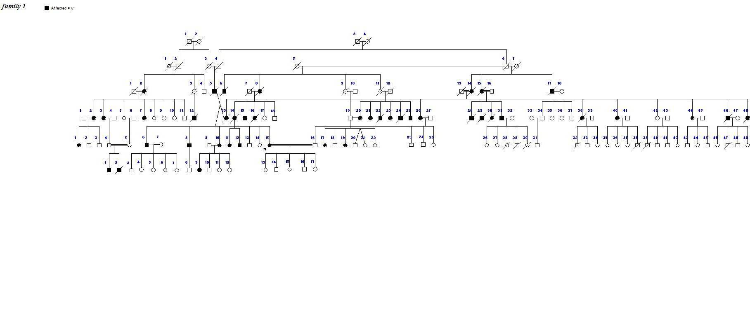
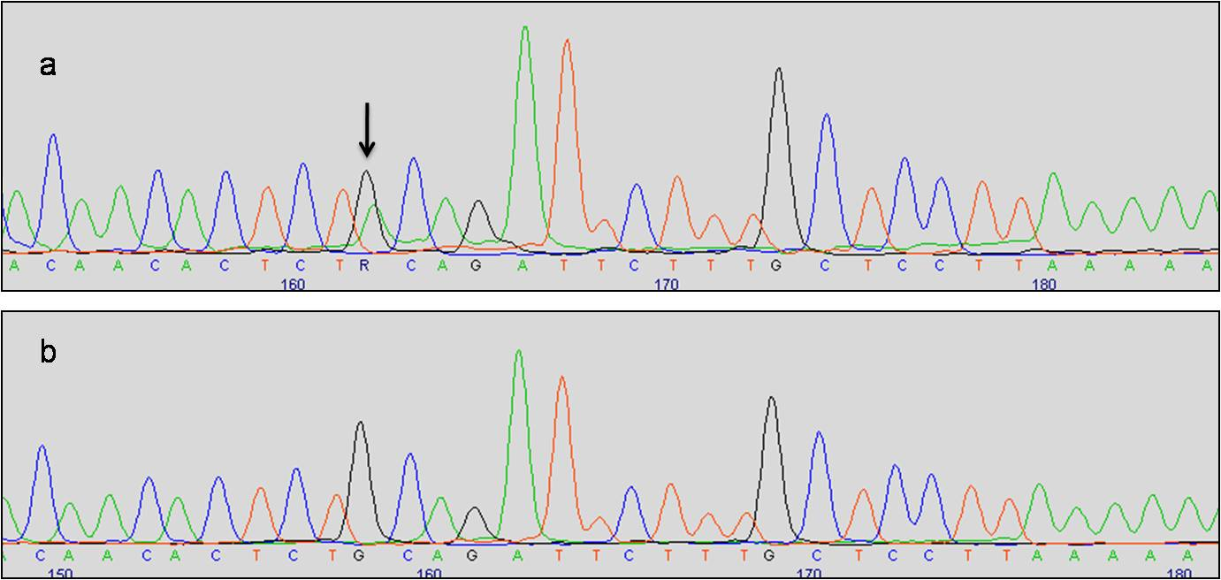
MSH2 exon 2 showing 226C>T heterozygous mutation (Arrow)

Slide 28
Summary and implications
Hereditary: FAP, HNPCC MSI
MSI
Serrated BRAF, CIMP-H
CRC
Sporadic
MSS, CIN, p53, Ki-Ras, miRNA
Personalized/tailored therapies
Ki-ras and Cetuximab
BRAF and Vemurafenib

Slide 29
Other neoplasms of Colorectum
GIST
Lymphoma
Neuroendocrine

Slide 30
Thank you
Any question?

