Slide 1
Neoplasia
Dr. Fahd Al-Mulla
http://www.al-mulla.org
http://www.youtube.com/watch?v=QEc6yR1LlVg

Slide 2
Neoplasia
Neoplasia I
Definition
Metaplasia, anaplasia, dysplasia, Ca in Situ, Benign vs. invasive carcinoma.
Classification and nomenclature
Histological features
Neoplasia II
Tumour grading and staging
Mechanisms and Types of cancer spread
Effects of tumours on host: local effects, cancer cachexia, paraneoplastic syndromes.
Carcinogenesis
Etiology (causes) of neoplasia.
Environmental carcinogens and process of carcinogenesis
Molecular Basis of Neoplasia

Slide 3
Neoplasia
Neoplasia is defined as: " an abnormal mass of tissue, resembling the tissue of origin, the growth of which exceeds and is uncoordinated with that of the normal tissues and persists in the same excessive manner after cessation of the stimuli that evoked the change."
Neoplasia has genetic and environmental causes. It is important to note that both play parts in causing neoplasia.

Slide 4
Neoplasia
Tumor
Irreversible
Morphological resemblance to tissue of origin
Functional resemblance to tissue of origin
Autonomy
Harmful

Slide 5
Metaplasia
Definition
Conversion of one type of differentiated tissue into another type of differentiated tissue.
It is a form of adaptation.
It is benign and reversible.
Stimulant causing metaplasia may persist and play a role in carcinogenesis.
e.g. Squamous metaplasia of bronchial respiratory epithelium in smokers.
e.g Columnar epithelium of endocervix replaced by Squamous epithelium in chronic inflammation of Cervix.
What is Hyperplasia? Dysplasia? Anaplasia?

Slide 6
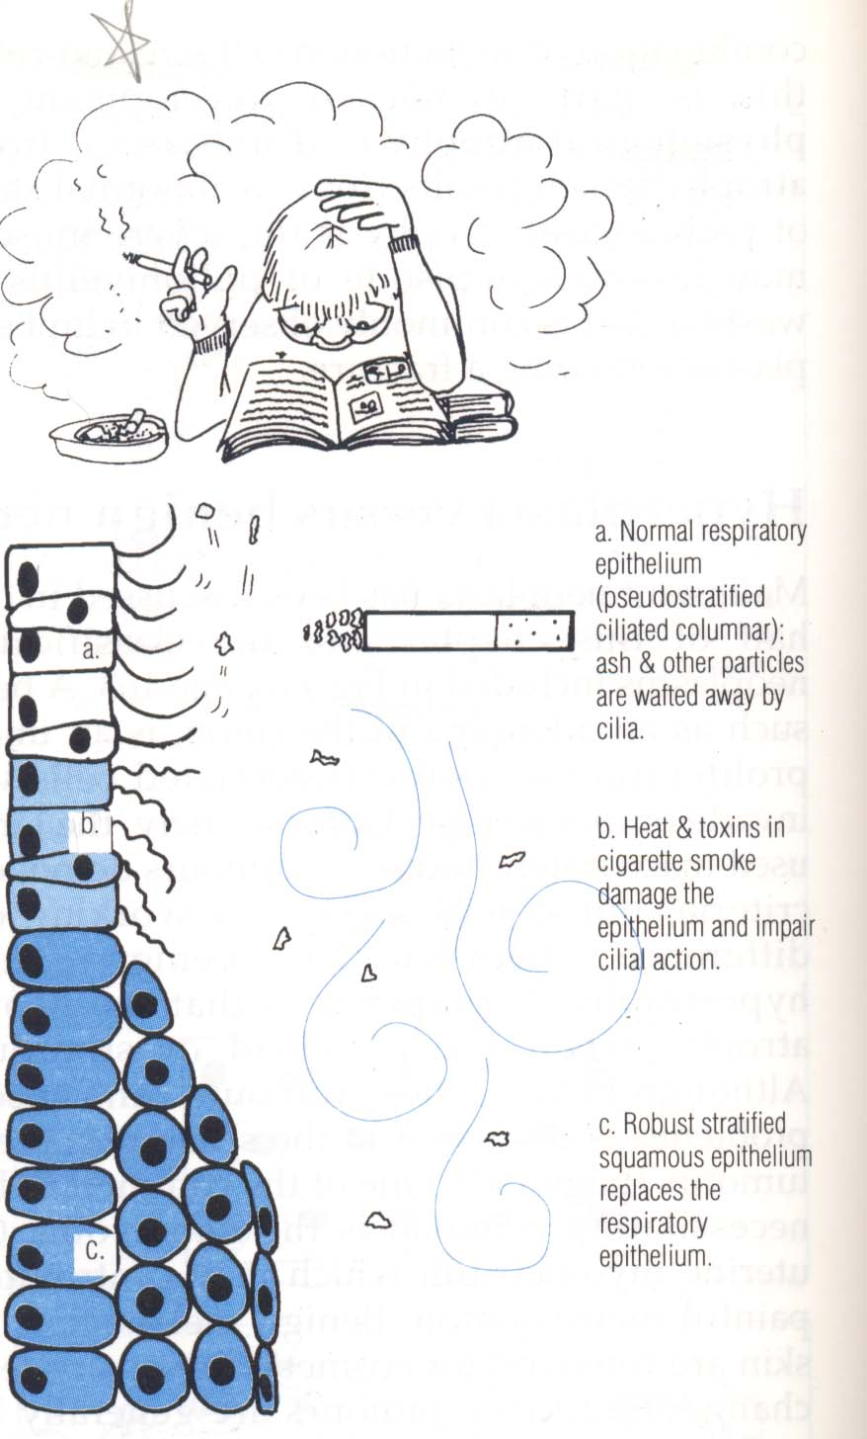

Slide 7
Benign neoplasia
Definition
Uncontrolled focal proliferation/growth of well-differentiated cells. Cells resembling the tissue of origin.
Does not invade or metastasise (mobile/smooth edges)
Encapsulated (fibrous capsule)
May show dysplasia
Adenoma of colon
Leiomyoma (fibroid) of the uterus
Menigioma
Endocrine tumors – produce hormones

Slide 8
Remember that something which is benign by the pathologist may have significant clinical effects on the patient:
Space occupying lesion (Brain/spinal cord)
Secret Hormones (Pancreatic insulinoma, parathyroid)
Some types colonic adenomas may later become anaplastic . Should be considered pre-cancerous.

Slide 9
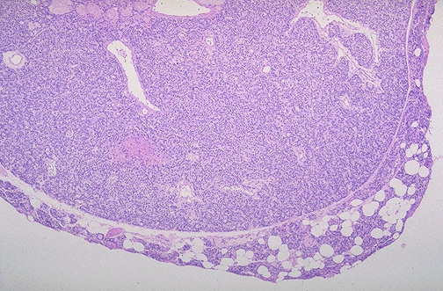
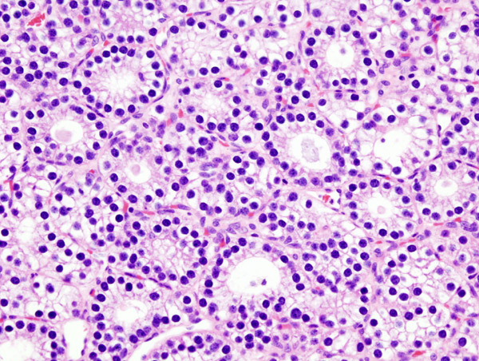
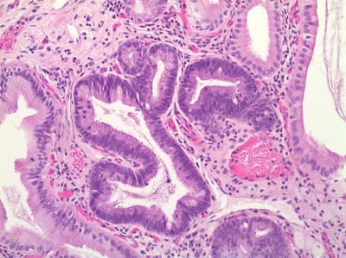
Parathyroid adenoma
Gallbladder Dysplasia

Slide 10
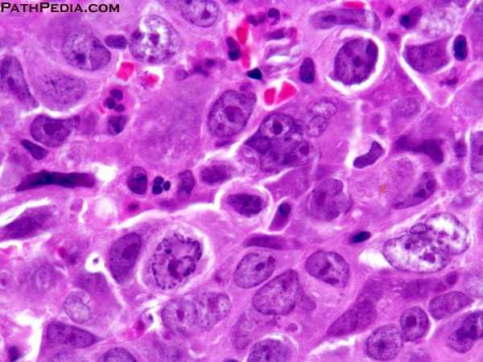
Anaplasia
Nuclear/cytoplasmic ratio
Hyperchromatism
Mitosis/abnormal
Pleomorphism
Necrosis
Angiogenesis
In situ cancer or cancer

Slide 11
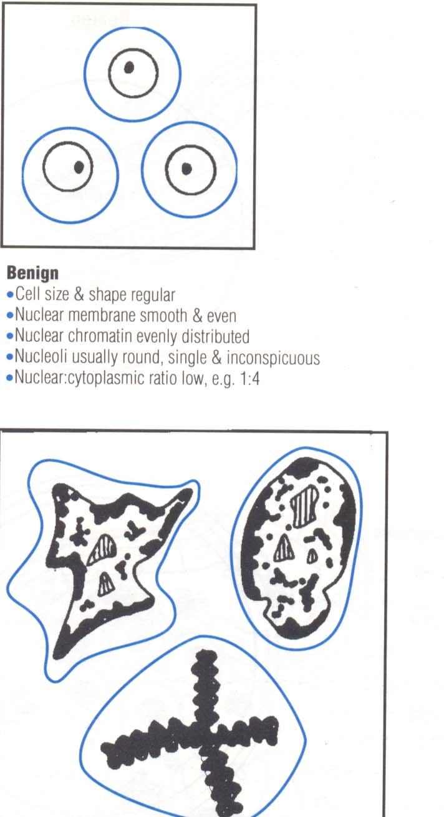

Slide 12
In-situ carcinoma
An alteration in architecture and cytological
appearance Which is similar to that seen in
malignant tumour that does not show any
invasion.

Slide 13
Dysplasia
Definition
Combination of abnormal cytological feature and abnormal tissue architecture.
It has pre-cancerous association.
e.g dysplasia in the cervical epithelium.
Increase cell size.
- hyperchromatism
- loss of orientation of the cells
- haphazardly and abnormally sited mitotic activity
- loss of maturation
- nuclear pleomorphism
Same as cancer features but differ in extent. When full thickness involved – carcinoma in-situ – severe dysplasia
lower third - mild dysplasia
two third - moderate dysplasia
e.g. CIN & VIN

Slide 14
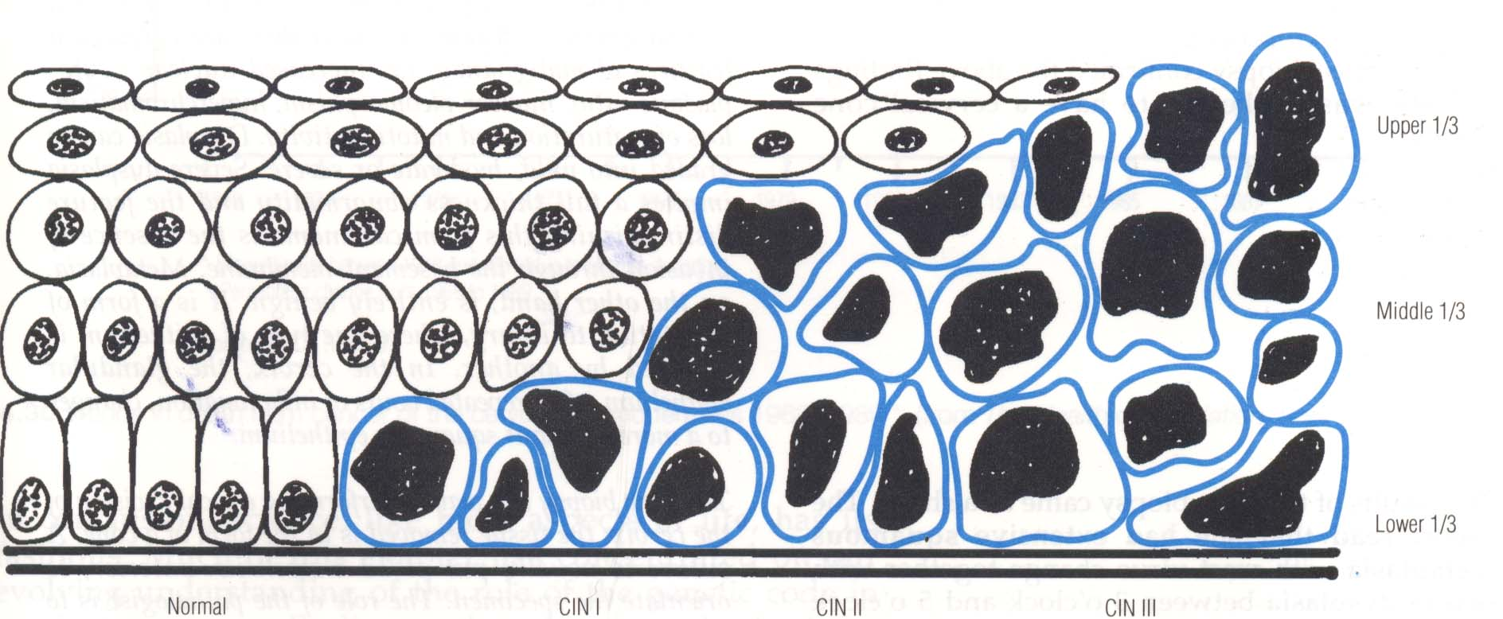

Slide 15
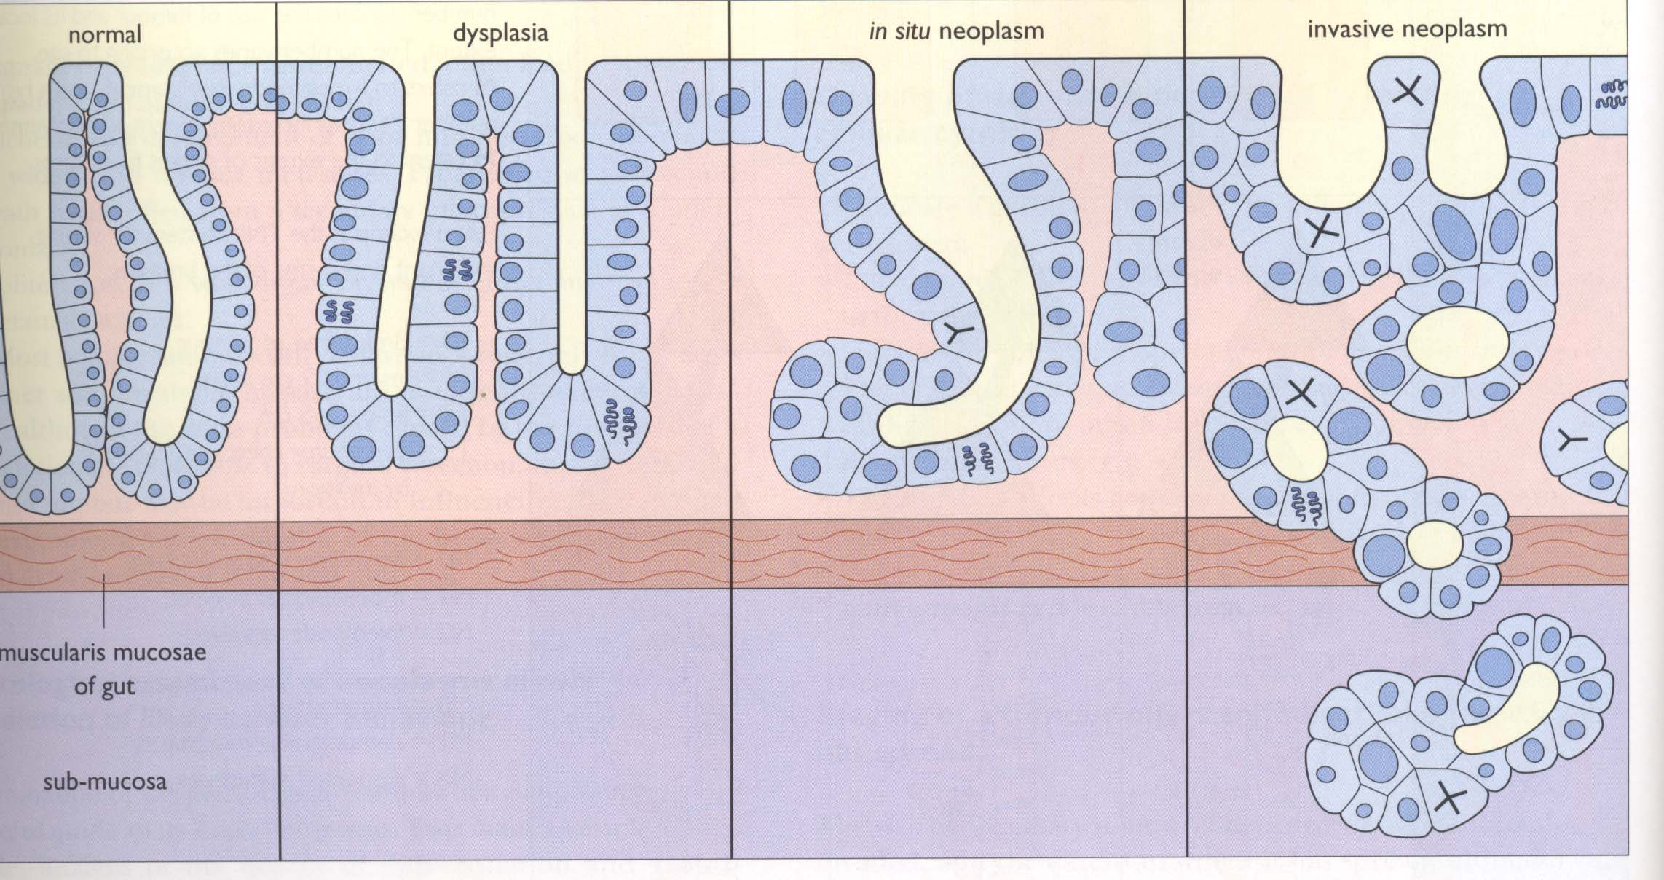
Anaplasia
Anaplasia

Slide 16
N.B.
Normal Dysplasia Anaplasia Invasion
Don’t assume that dysplasia is irreversible. Mild dysplasia may revert to normal if stimulus removed
(managed less agressively but followed up).
Severe dysplasia often progress to cancer if left untreated
(treated as a favourable type of cancer).
The Concept of dysplasia as a Cancer in its early stages has led to institution of screening programmes for cervical and breast cancer.

Slide 17
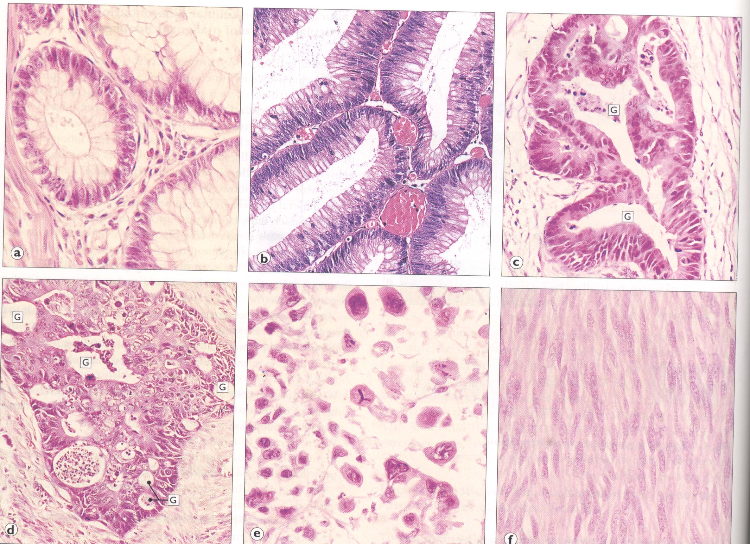

Slide 18
Invasion and Metastasis WHOLE MARK OF CANCER ©
Astrological cancer sign

Slide 19
Classification of tumors
Epithelium
Benign: Papillomas, adenomas, polyps
Malignant: Carcinomas (Adenocarcinomas, glands)
Non-epithelial tissues: connective tissue -Sarcoma
lymphoid tissue-Lymphoma
mesenchymal/mesodermal origin --Oma, --Sarcoma
Epithelial & non-epithelial tumors ONE TYPE OF TISSUE (Unipotent)
Blastoma: Malignant, consists of tissues resembles the embryonic counterpart from which the tumor originates (Nephroblastoma, Wilm’s tumor in Kidney) Multipotent
Teratoma: Benign/or malignant germ cell (Totipotent) tumors. Gonads/midline of the body. Can form any type of tissue
Blastoma & Teratomas more than one type of tissue

Slide 20
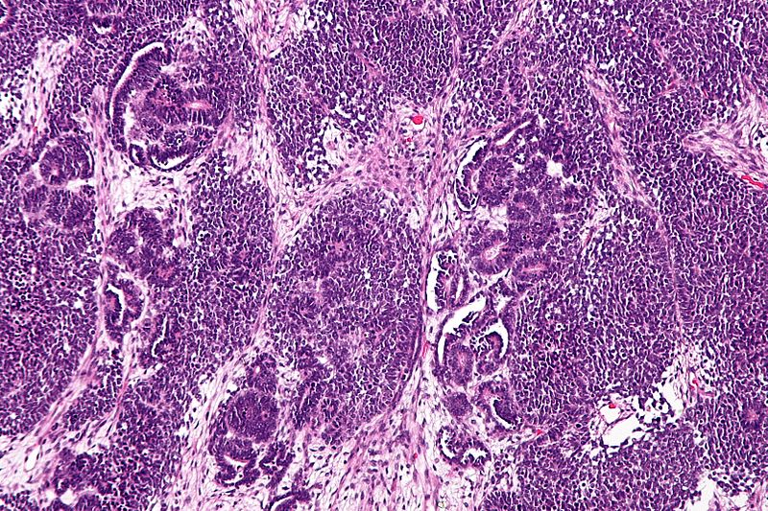
Nephroblastoma

Slide 21
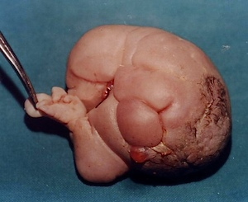
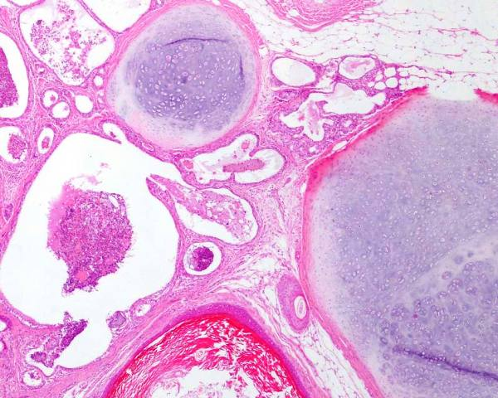
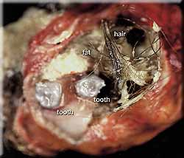
Teratoma

Slide 22
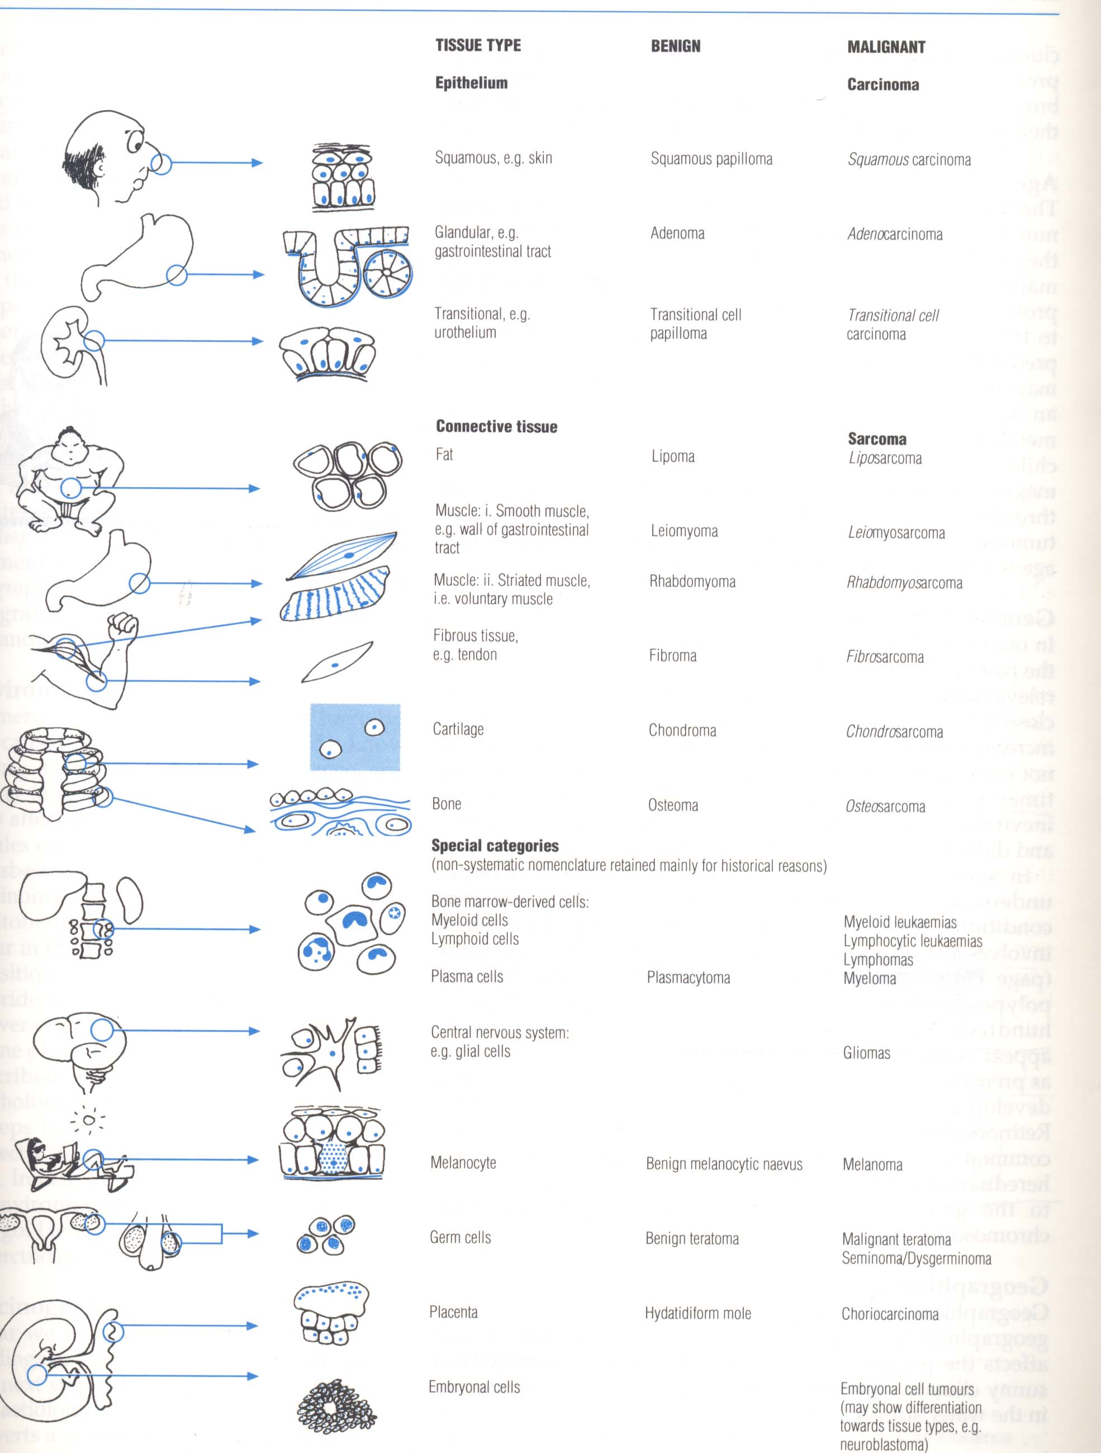

Slide 23
Choristoma:
Aggregate of normal ectopic tissue at another site
Eg. Normal pancreatic tissue at wall of stomach
Hamartoma:
A mass consisting of abnormally organized cartilage, blood vessels, bronchi, alveoli
Teratoma:
Ovarian mass show teeth, adipose tissue, hair, sebaceous material, thyroid tissue etc.
Can be seen in testis

Slide 24
What factors influence prognosis?
Type of tumour
Grade of tumour
Nottingham index, Gleason etc
Stage of the disease
( American Joint Committee on Cancer (AJCC) TNM system.)

Slide 25
Histological grading
How much the tumor resembles normal tissue
Classify cancer cells in terms of how abnormal they look under a microscope
Oncologists consider tumor grade and other factors when developing an individual treatment plan
Histological grade is called Differentiation
Nuclear grade refers to size/shape of nuclei
Grading is different than staging but is used in staging cancer

Slide 26
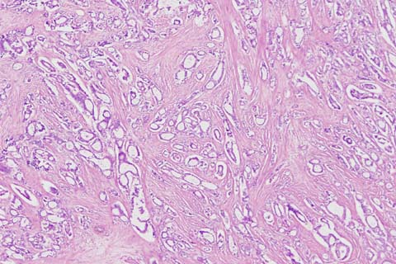
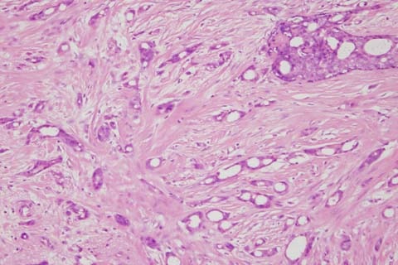
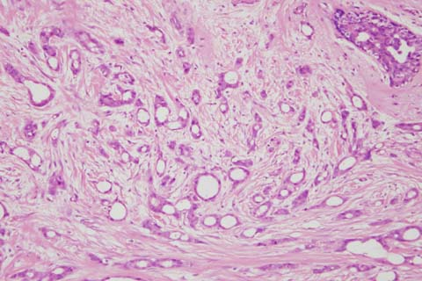
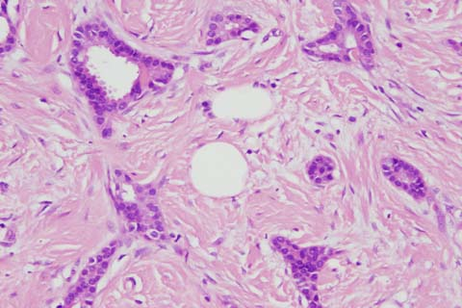
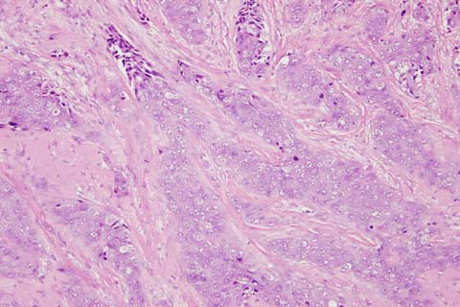
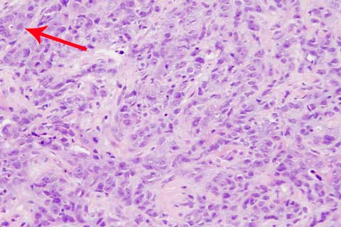
Breast Cancer grade
Grade 1 >75% tubules
Well differentiated
Grade 2 <10-75% tubules
Moderately differentiated
Grade 3 <10% tubules
Poorly differentiated

Slide 27
Tumour stage American Joint Committee on Cancer (AJCC) TNM system.
Depends on pathological and clinical information
CT scan, US, bone marrow examination….etc.
TNM staging system
T - primary tumour
N - regional lymph node involvement
M - Metastasis
Help to - decide treatment
- predict outcome

Slide 28
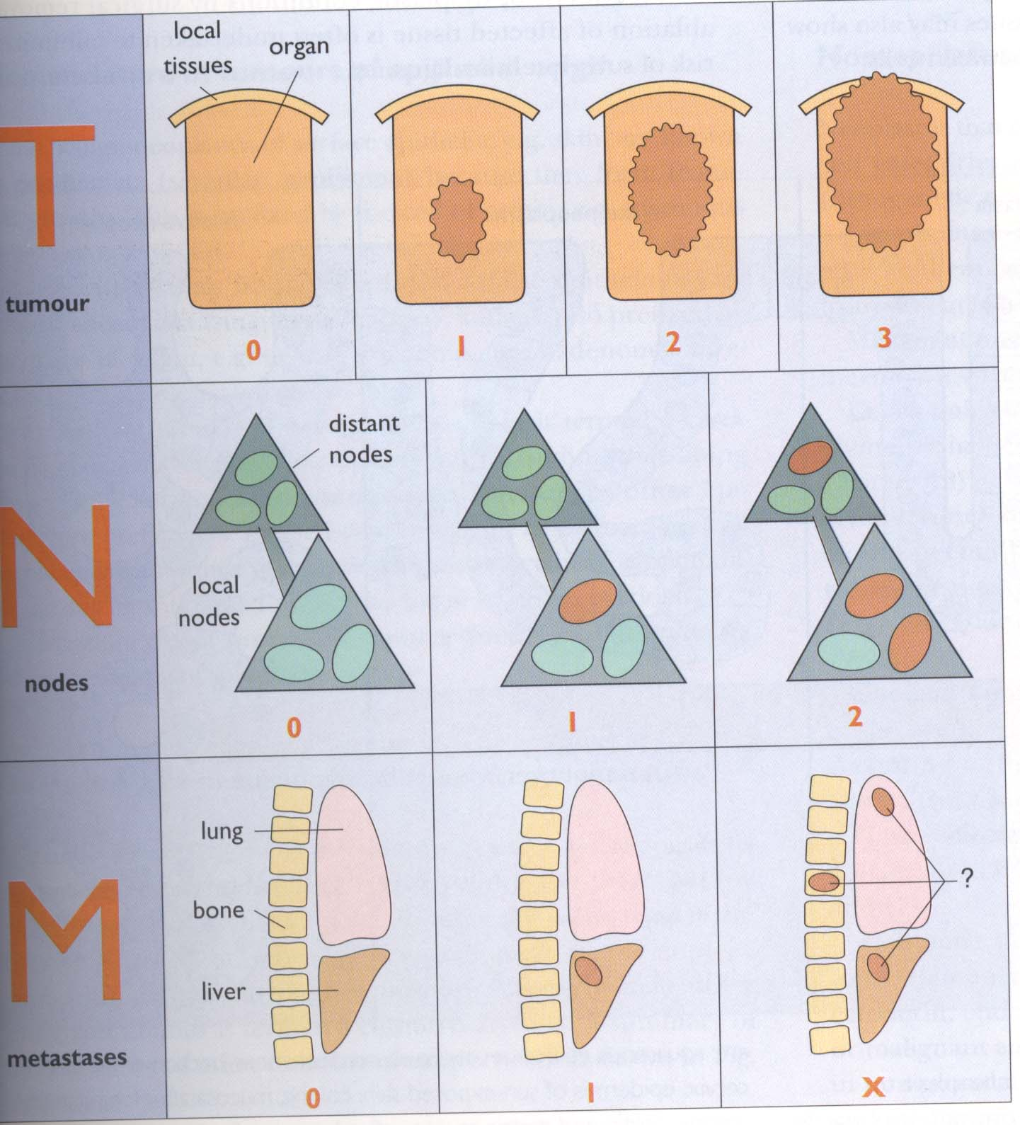
<=2cm
2-5cm
>5cm

Slide 29
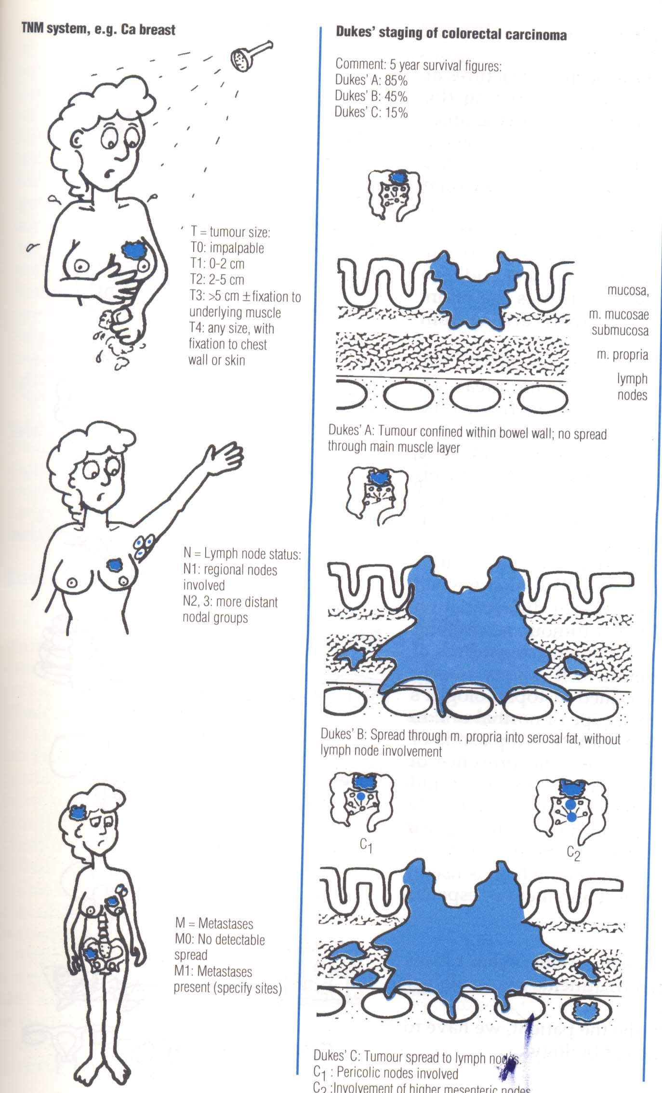

Slide 30
Cancer metastasis
Metastasis is defined as the development of secondary implants discontinuous with the
primary Malignant neoplasm in remote tissues. Cancers spread by three ways:
Direct spread
Lymphatic spread (via lymphatic vessels)
Haematogenous spread (via veins) Why not arteries??
Metastasis is a multi-step process
Cells invade through a thick layer of basement membrane (BM)
Production of a collection of proteolytic enzymes
Cells then reach blood or lymphatic vessels by which they are transported to distant sites
The tumour cells then extravasate from the vessels to colonize distant organs
Major cause of metastasis inefficiency is failure of cells to grow in distant sites post-extravasation (Chambers et al., 1995; Koop et al., 1996). Low apoptosis means better metastasis

Slide 31
Metastasis
Direct
Lymphatics - common in carcinoma
Venous - GI tumours to liver
Various site to lung, brain, bone, bone marrow, any organ?
Seeding Ovarian cancer
Hematogenous Osteosarcomas
Kidney
Paget’s soil and seed
Very rare in Skeletal Muscle! Why?
Molecular defect determines site of metastasis
Apoptosis resistance most important characteristic

Slide 32
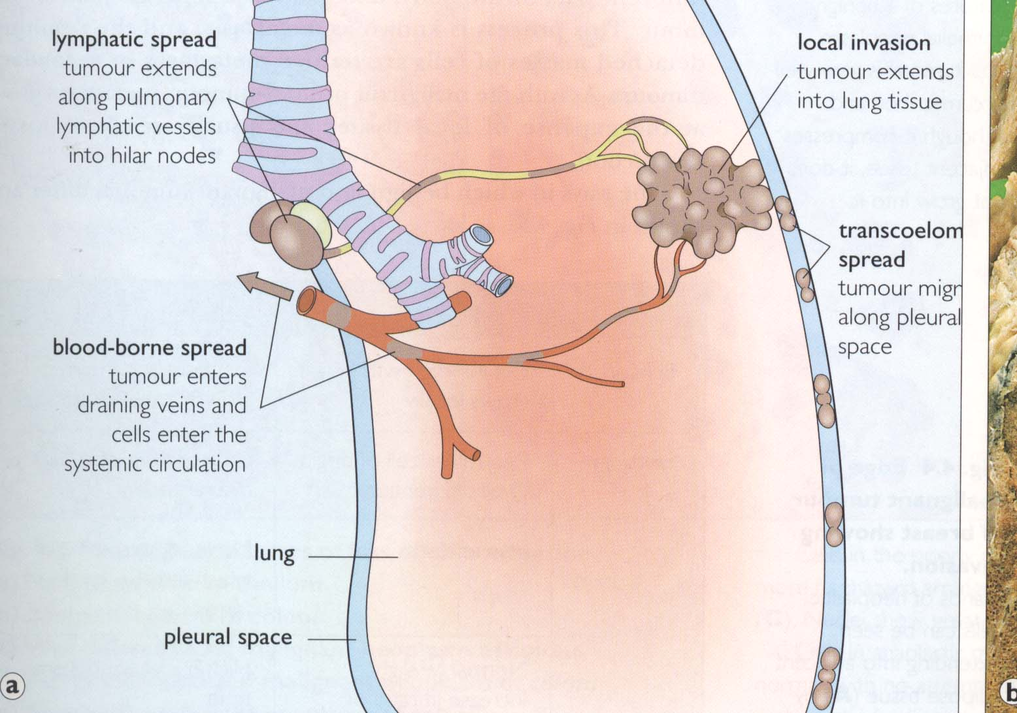

Slide 33
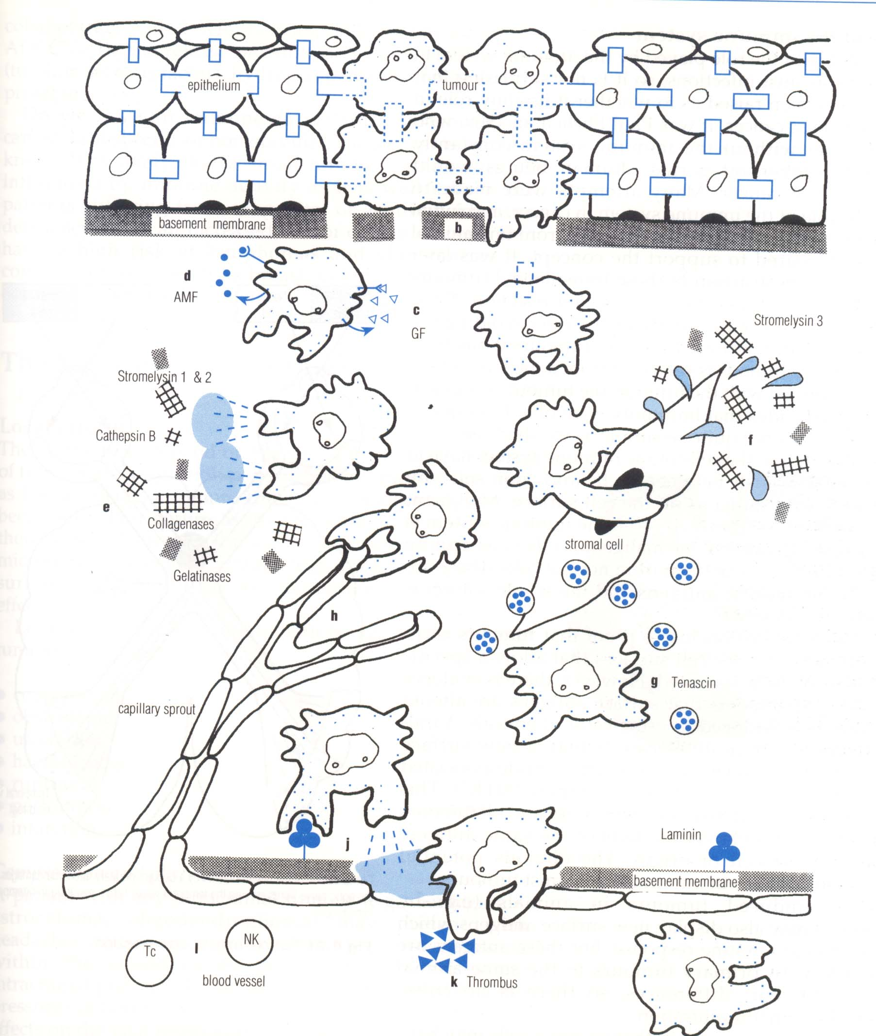

Slide 34
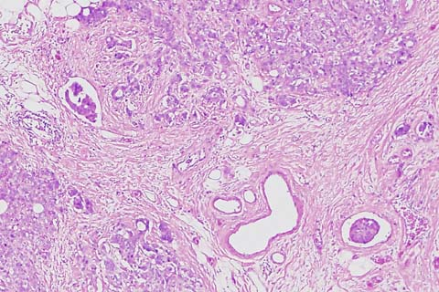
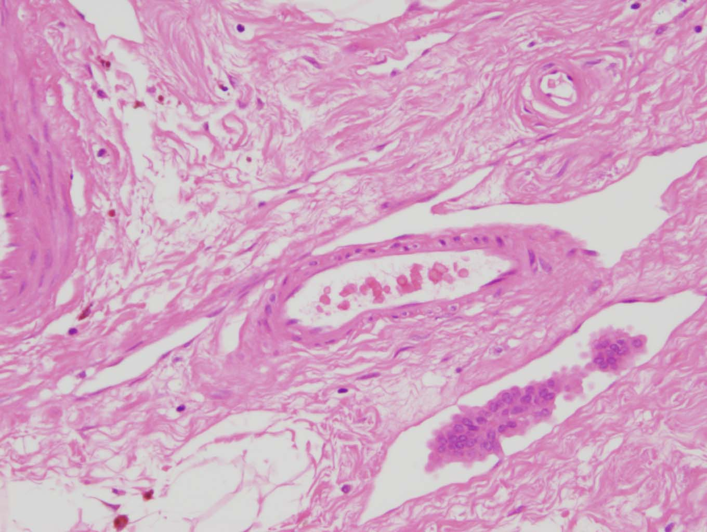
Lymphatic Invasion Vascular (Vein) invasion

Slide 35
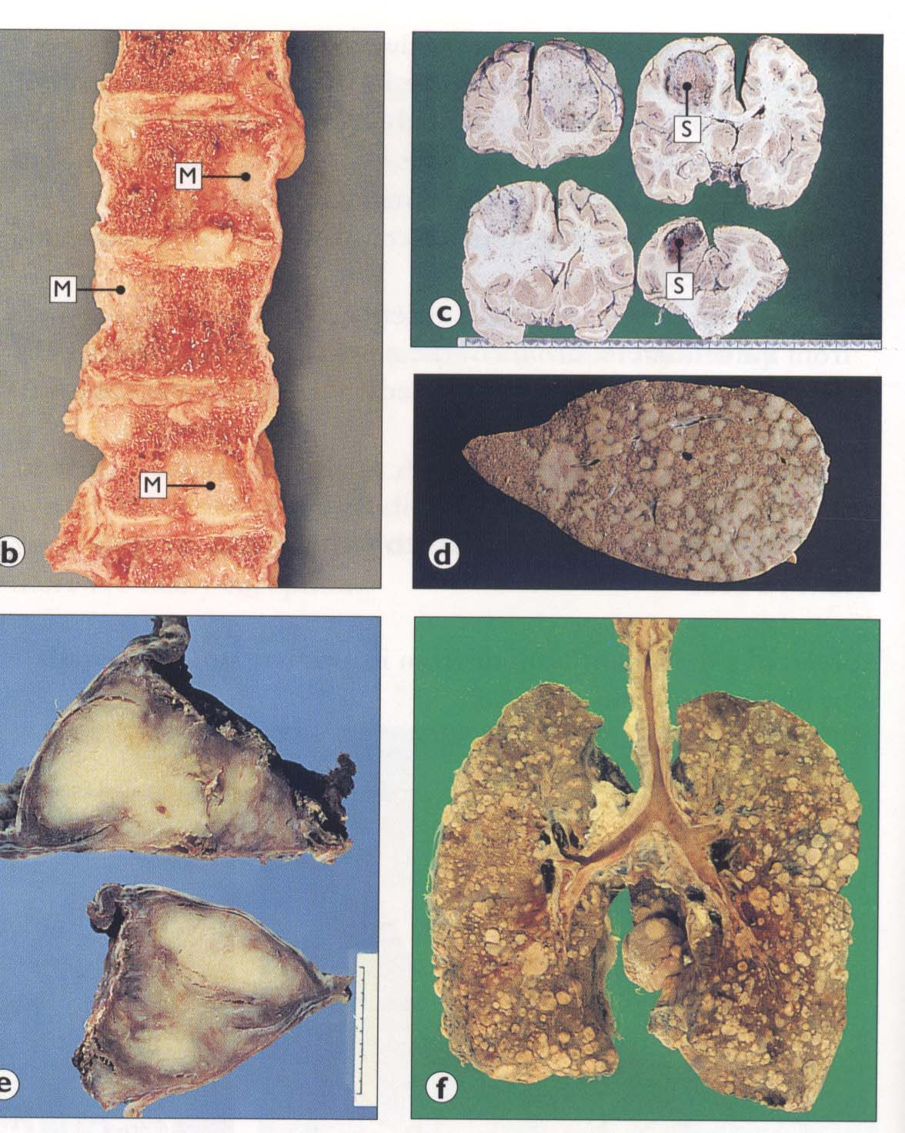

Slide 37
The Clinical effect of tumors
Local effect
Compression – Intracranial pressure (brain tumours)
& Obstruction ( esophagus)
Ulceration (Skin)
& hemorrhage ( Blood vessels)
Rupture ( G.I. Tract)
or perforation or obstruction
4. Infarction
in the central region of tumour only expand 1-2mm in diameter.
New vessel formation (Angiogenetic factors)
5. Endocrine effects

Slide 38
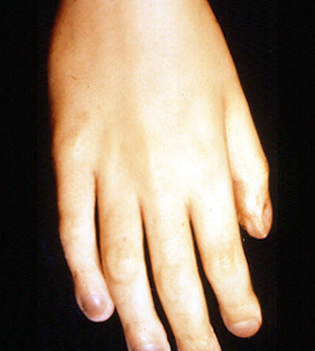
Systemic effects
Weight loss and Cachexia

